Slide 1
How to globally update the expiration date for a set of users
Yoel Kortick
Senior Librarian
January 2025

Slide 2
Agenda
Introduction
Our sample set
Globally updating the Expiration Date
Check the results of the job
2

Slide 3
Introduction

Slide 4
Introduction
In this presentation we will globally change the expiration date for a set of users.
We will assume that the set of users already exists.
For information on how to create a set of users using Alma Analytics see the following examples:
  How to create a set in Alma (using Alma Analytics) of all users that have an item on loan.pptx
  How to create a set in Alma (using Alma Analytics) of all users that have an expiration date in the past.pptx
For information on how to create a set of users in Alma see:
  Creating Itemized Sets
  User Sets

Slide 5
Our sample set

Slide 6
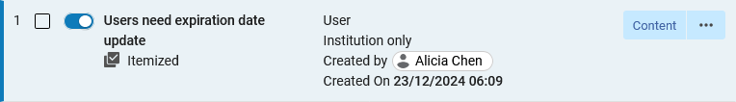
Our sample set
We have a set named “Users need expiration date update”

Slide 7
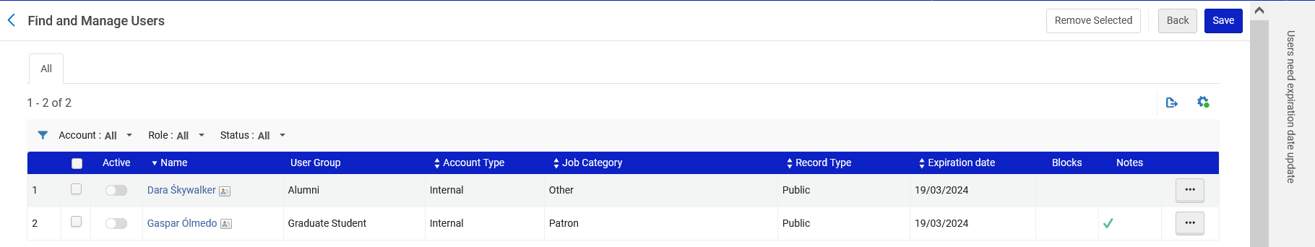
Our sample set
The set named “Users need expiration date update” has two users, each of whom have an expiration date 19/03/2024

Slide 8
Globally updating the Expiration Date

Slide 9
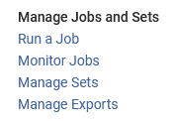
Globally updating the Expiration Date
Now we will run the job “Update/Notify Users”.
We will access the job via “Admin > Manage Jobs and Sets > Run a Job”:

Slide 10
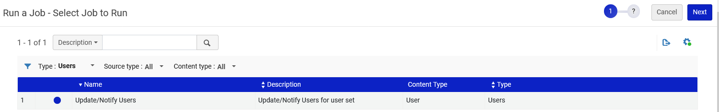
Globally updating the Expiration Date
Now we will run the job “Update/Notify Users”

Slide 11
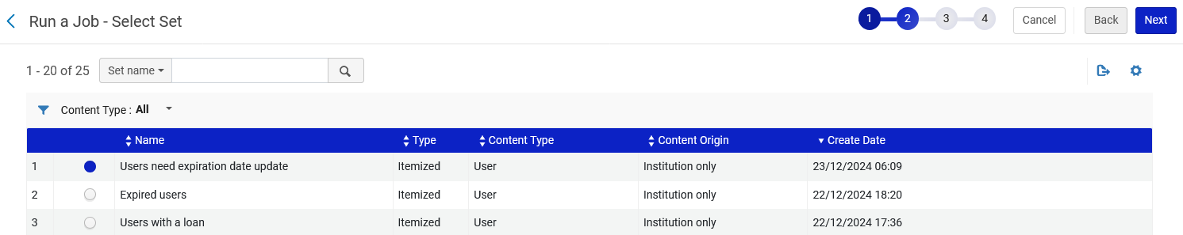
Globally updating the Expiration Date
We will choose the set we just looked at

Slide 12
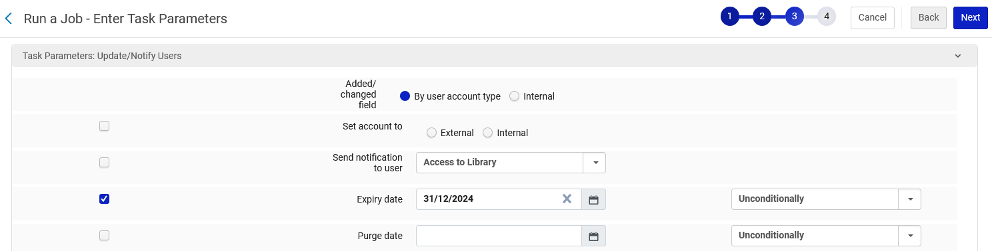
Globally updating the Expiration Date
We will change the Expiry date to Dec. 31, 2024

Slide 13
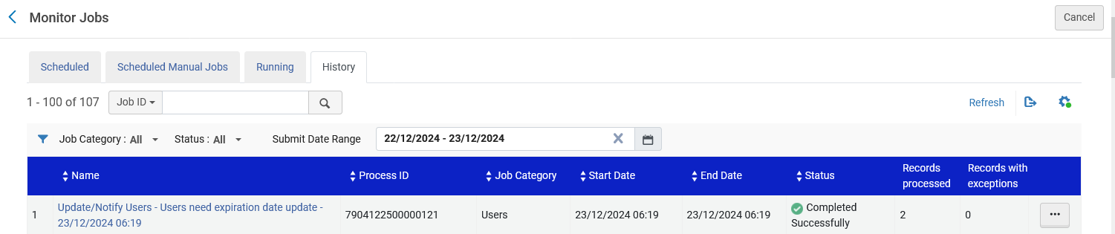
Globally updating the Expiration Date
The job completes

Slide 14
Check the results of the job

Slide 15
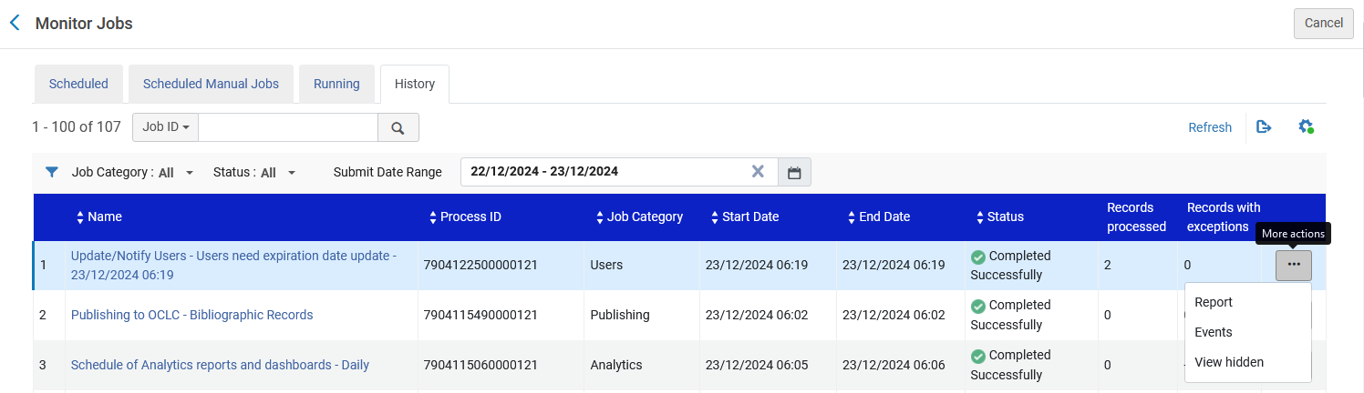
Check the results of the job
Let’s look at the job report.

Slide 16
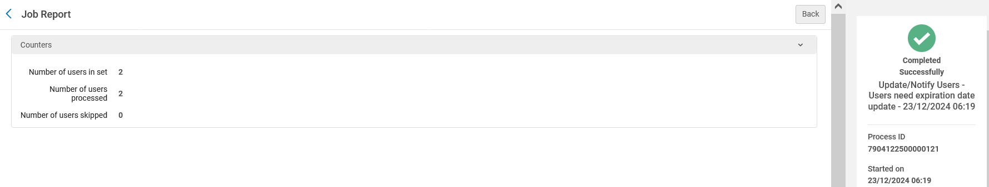
Check the results of the job
It states that two users were in the set and two users were processed

Slide 17
Check the results of the job
Let’s again look at the contents of the set

Slide 18
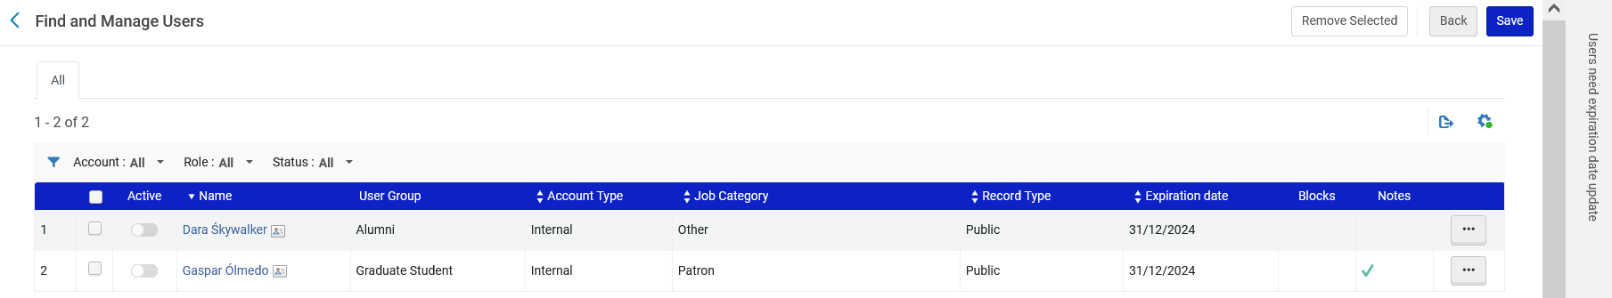
Check the results of the job
We see that the expiration date has been updated for both users

Slide 19
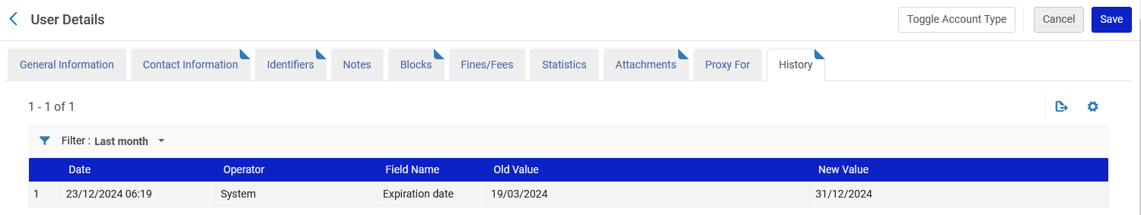
Check the results of the job
In the history tab of the user we can see that the change was made by “System” (the job)

Slide 20
Check the results of the job
Note that both users are still not “Active”

Slide 21
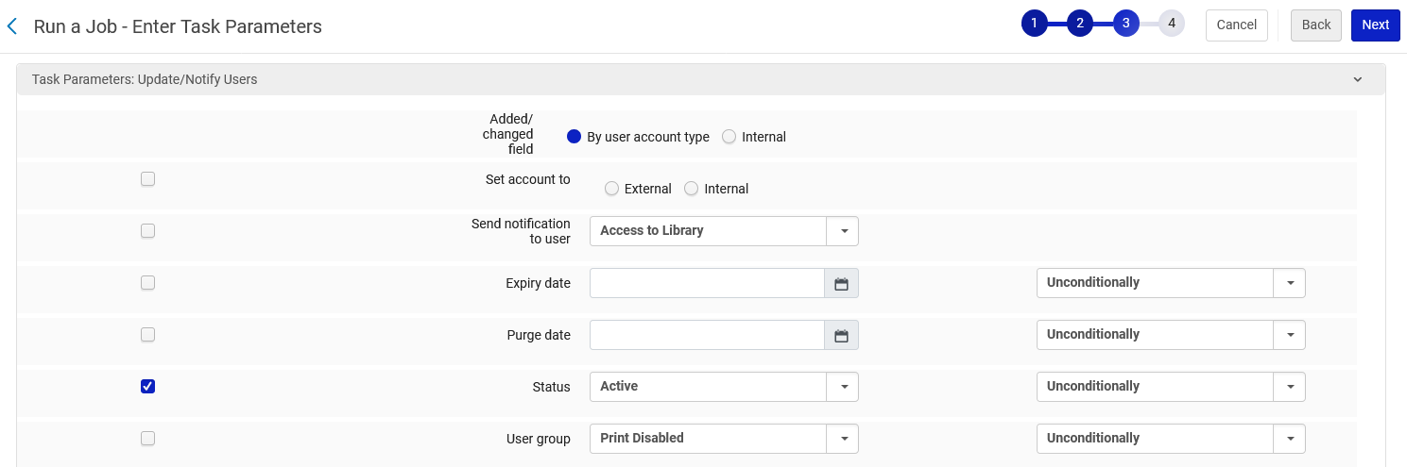
Check the results of the job
When we ran the job “Update/Notify Users” to update the expiration date we could have also (at the same time) changed the users to be active.
We will run the job again now and update the “Active” status.

Slide 22
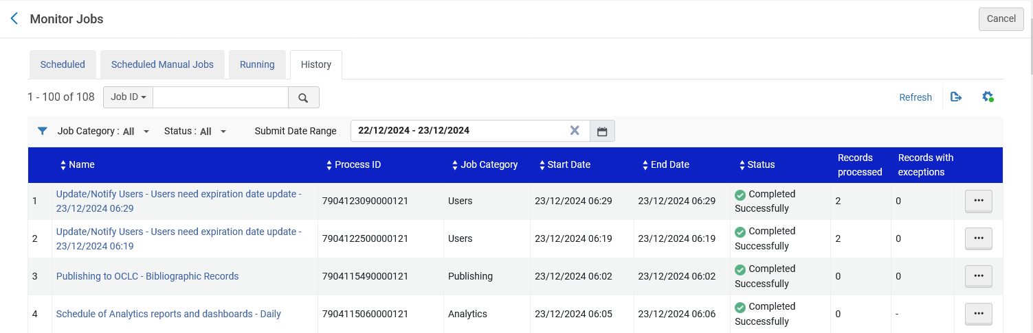
Check the results of the job
The job completes

Slide 23
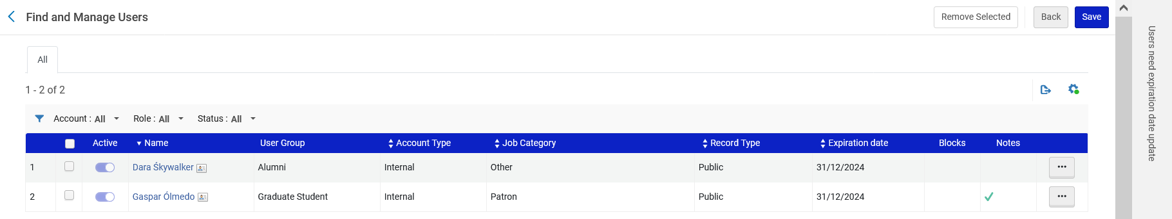
Check the results of the job
Now the users in the set are active

